Slide 1
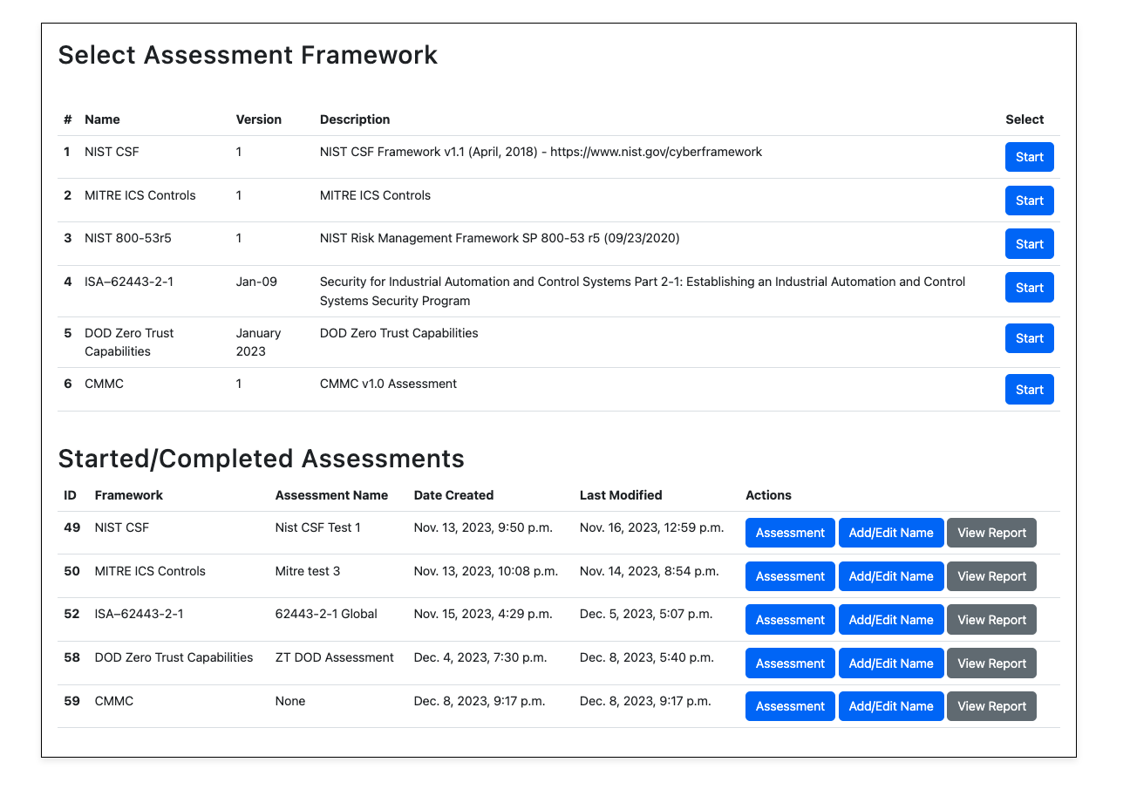
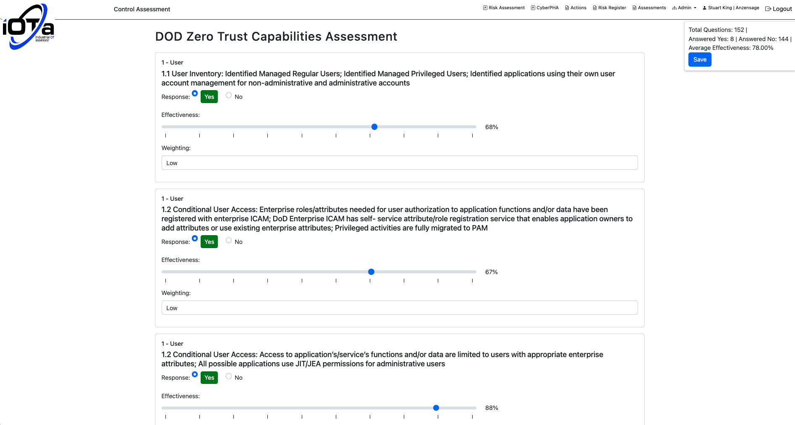
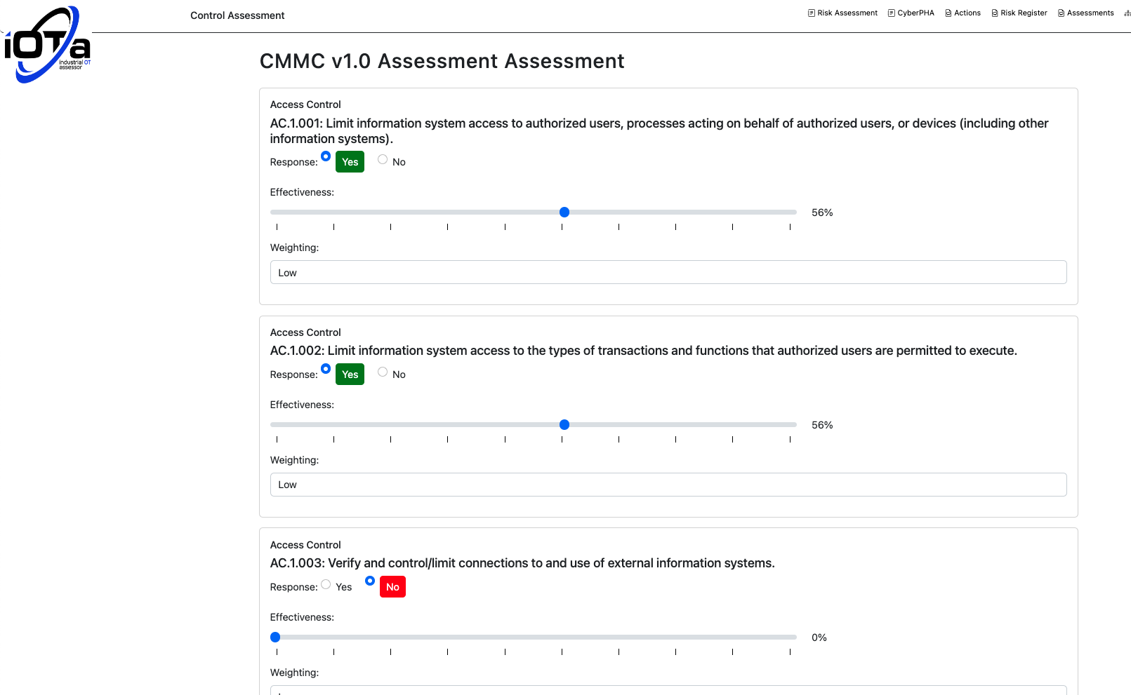
iOTa has built in assessments, allowing users to self-assess the effectiveness of their controls against common frameworks and regulations. Users may also upload their own control assessment

Slide 2
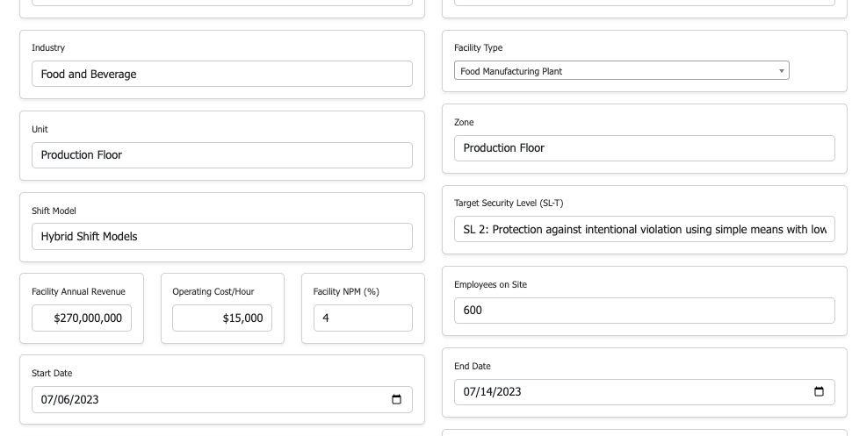
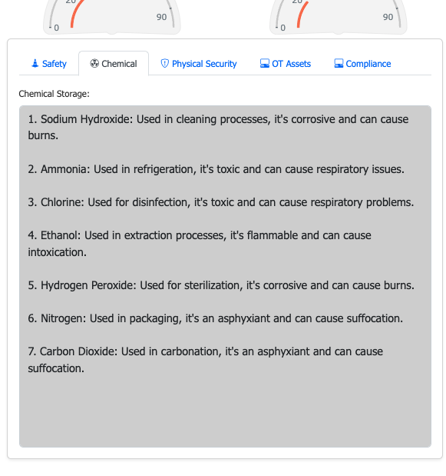
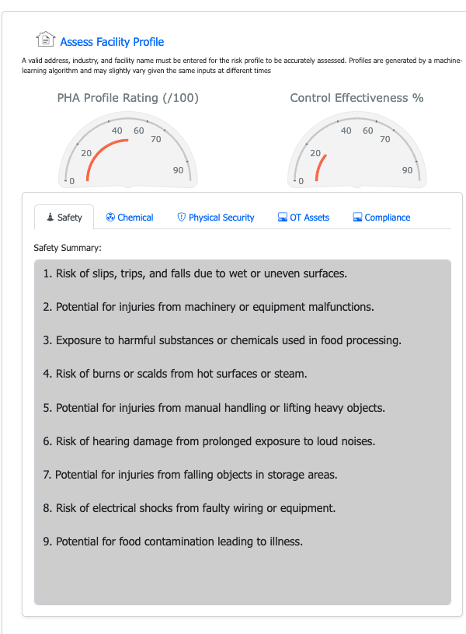
Creating a new CyberPHA assessment uses AI to generate a profile for the facility. Target-Security Level aligns the CyberPHA with ISA 62443-3-2

Slide 3
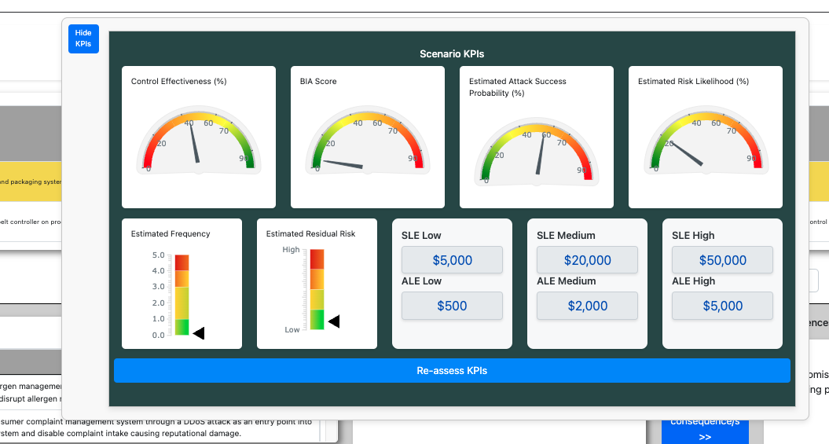
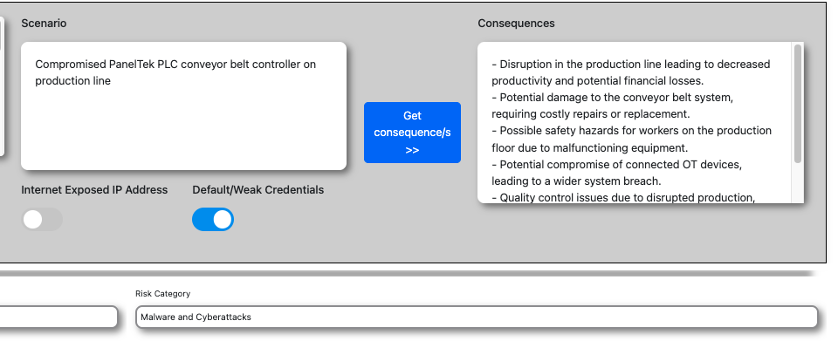
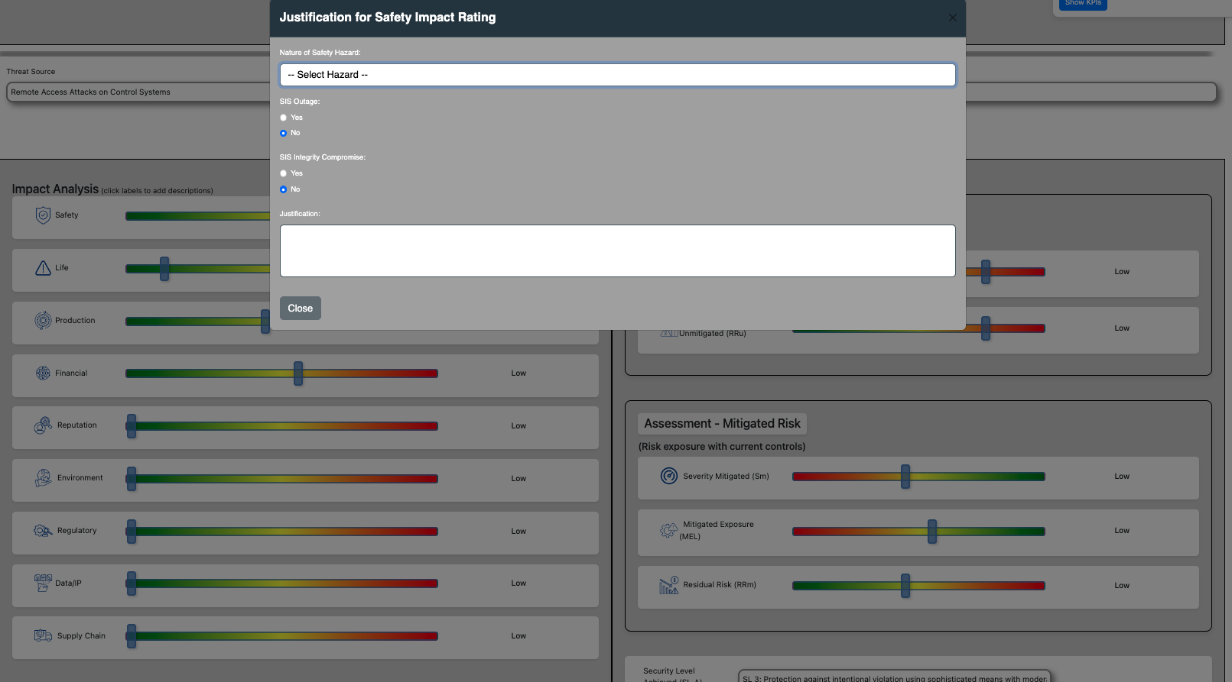
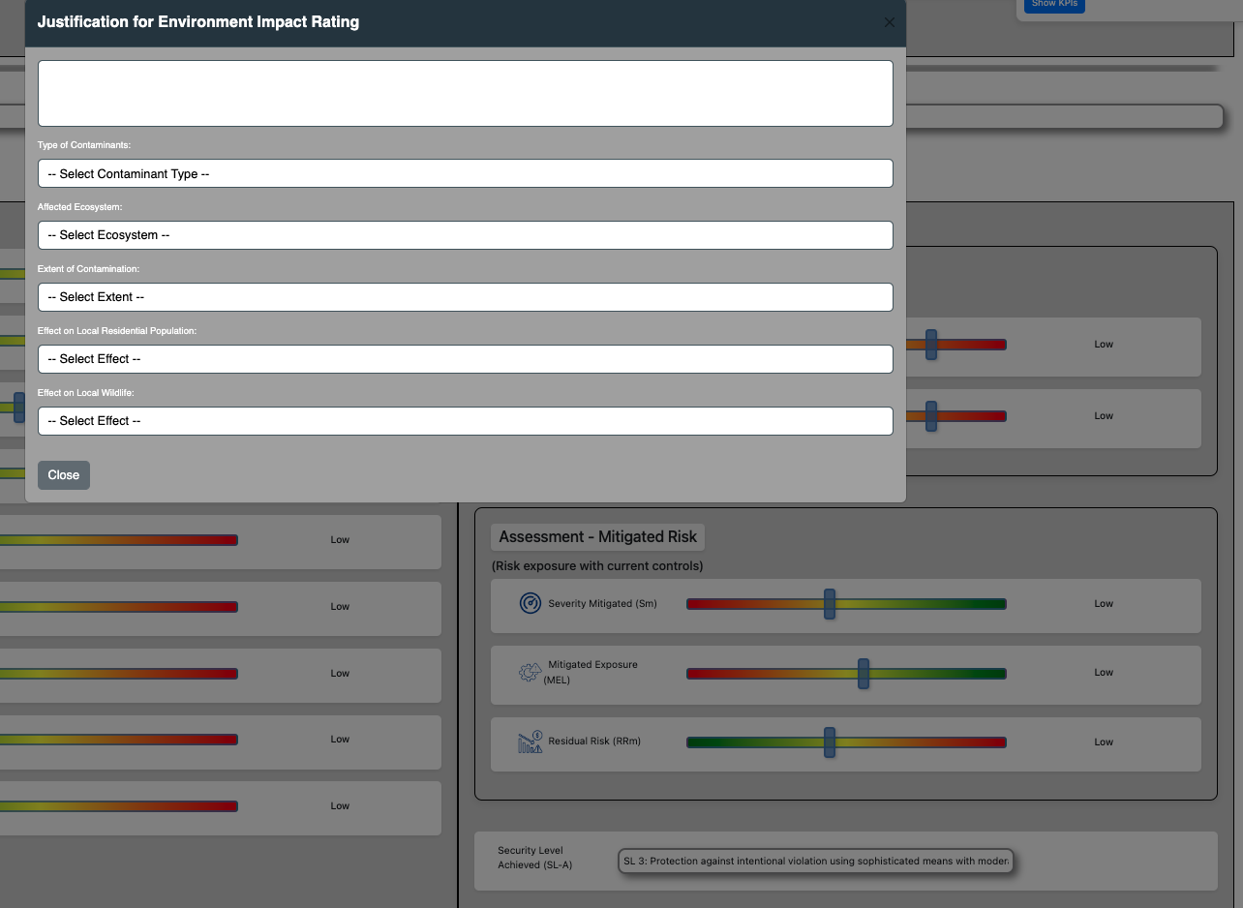
Any number of scenarios can be analysed for each CyberPHA. KPIs are generated using AI to determine attack success probability, risk likelihood and most likely event costs

Slide 4
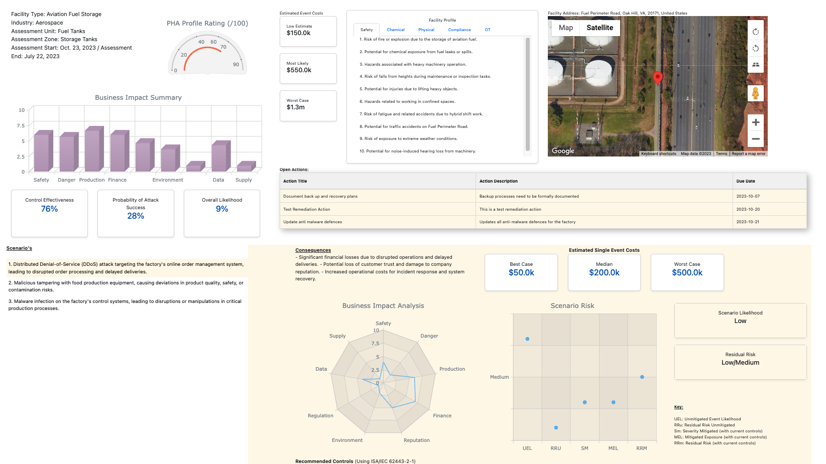
CyberPHA Report Output

Slide 5
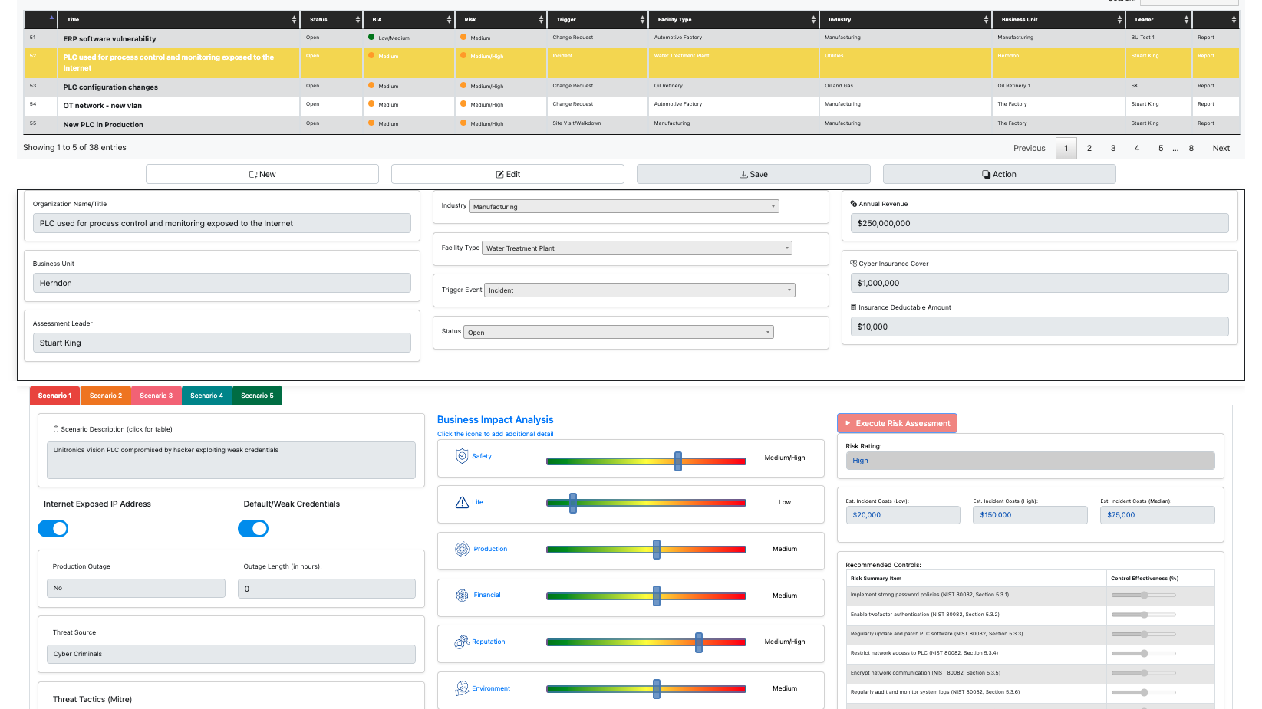
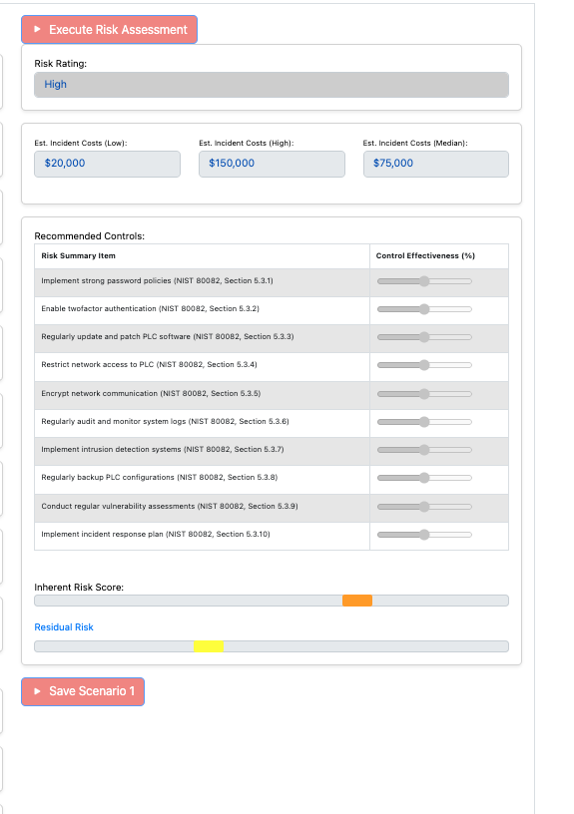
Quick Risk Assessment screen: analyse up to 5 scenarios. Output control recommendations aligned with NIST 800-82

Slide 6
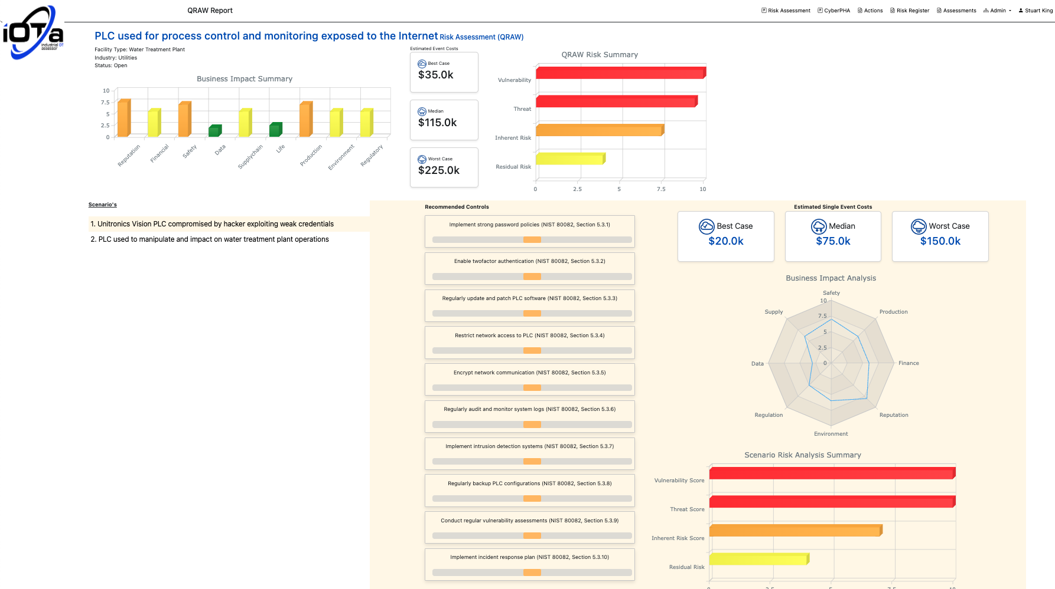
Quick Risk Assessment Report Screenshot

Slide 7
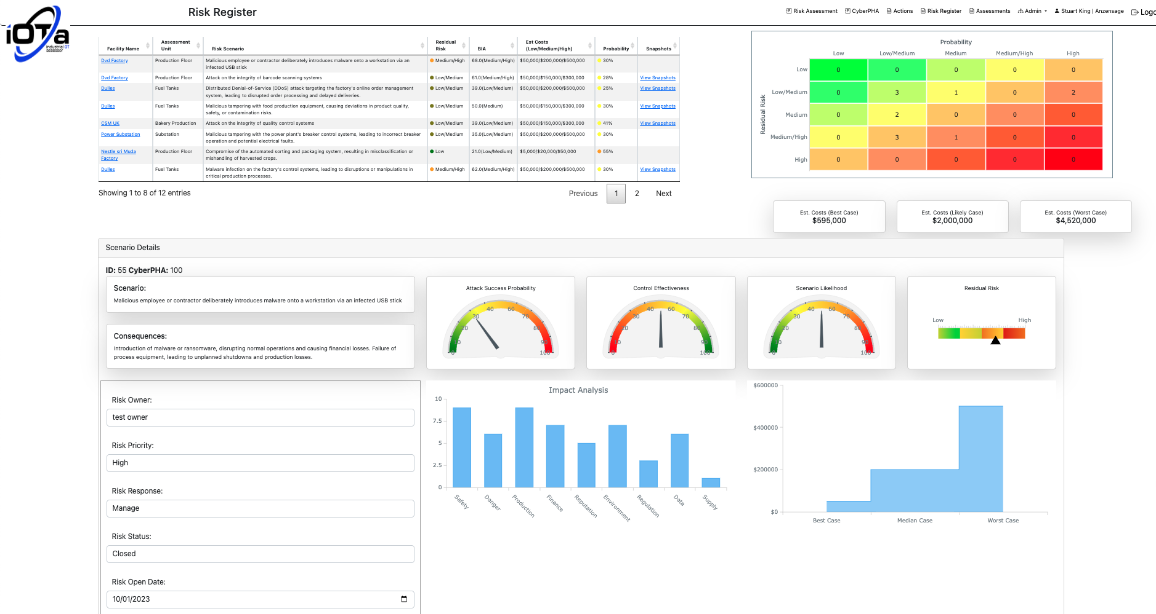
iOTa Risk Register

Slide 8
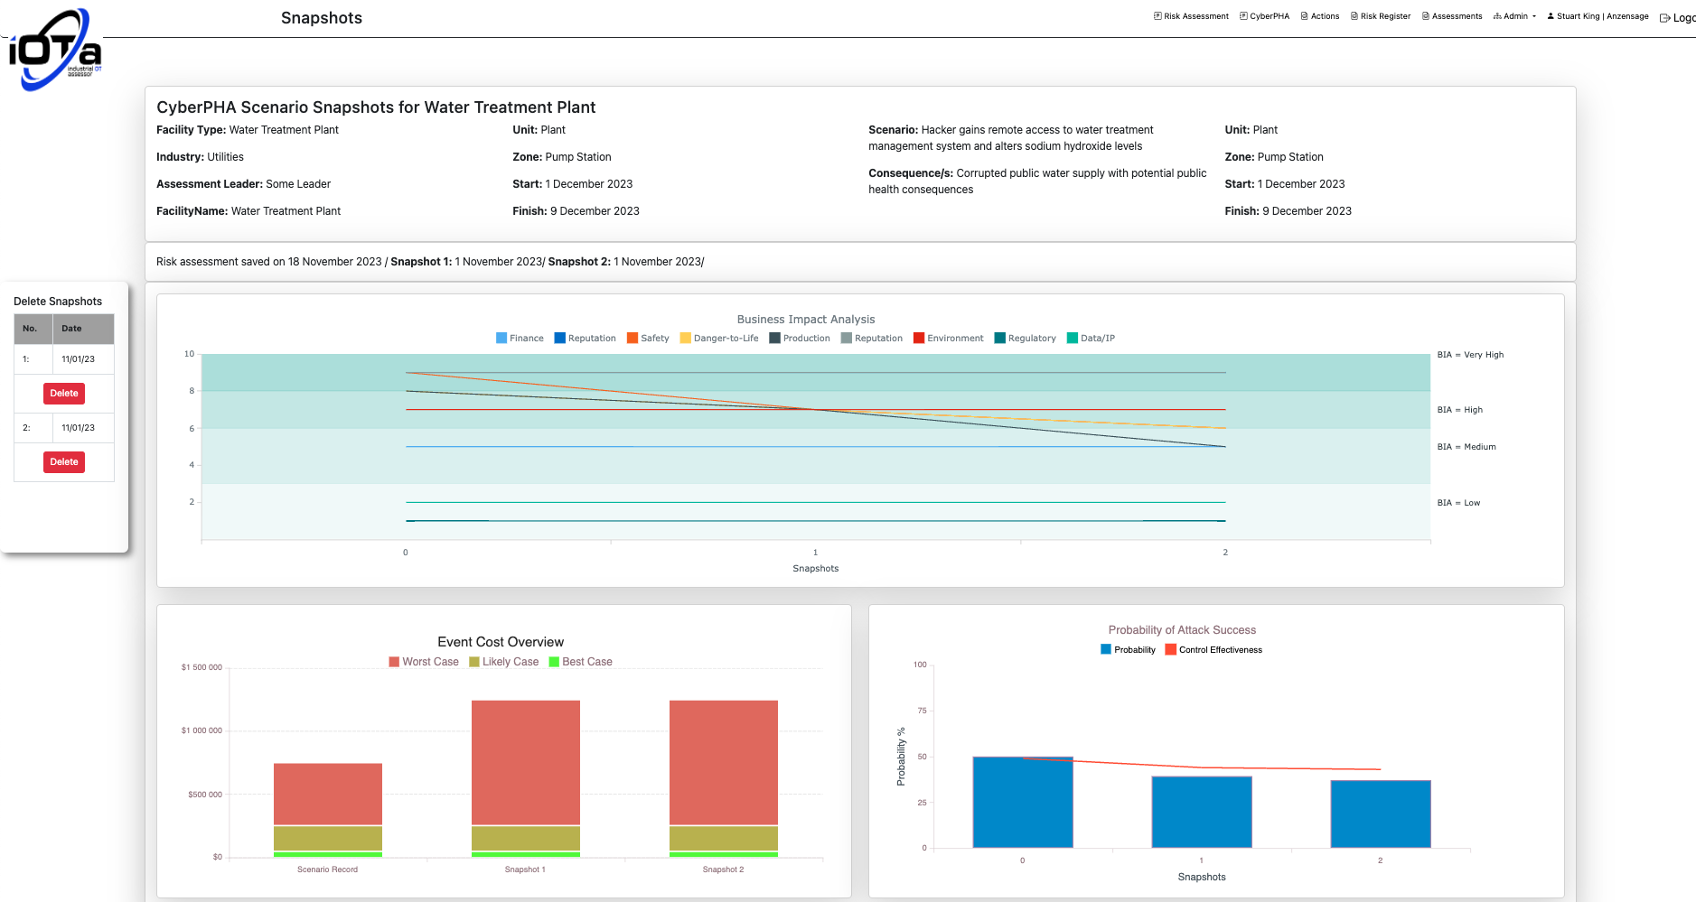
Risk Register Snapshot View

Slide 9
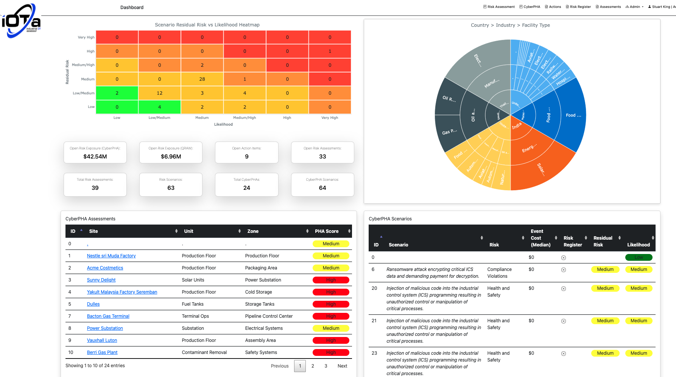
iOTa Dashboard

